Slide 1
Experimental Study to Identify the Emotion in Food Reviews
Amir Ali & Stanisław Matuszewski & Jacek Czupyt

Slide 2
Outline
Introduction & Problem Statement
Related Work
Data Collection
Exploratory Data Analysis
Data Processing
System Architecture
Result and Discussion
Conclusion and Future Works
References

Slide 3
Introduction & Problem Statement
The objective of the project was to use NLP methods to extract the overall sentiment of a piece of text, specifically a food review, in order to discern whether it is very negative, negative, neutral, positive, very positive.
The developed model can be used to quickly and effectively estimate the sentiment of unlabeled comments.

Slide 4
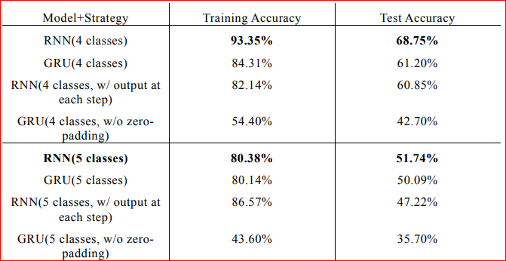
Related Works
Sentiment Classification of Food Review [1]
Table 1: Result Comparison
[1] Feng, Hua, and Ruixi Lin. "Sentiment Classification of Food Reviews." ArXiv, (2016). https://doi.org/10.48550/arXiv.1609.01933.

Slide 5
Data Collection
We to use the following datasets for this project:
Amazon Fine Food Reviews [2] - a dataset which contains over 500k reviews of fine foods from amazon
Food Reviews [3] - our user reviews dataset from the previous project - over 12k food recipe reviews acquired from the website TasteOfHome
[2] https://www.kaggle.com/datasets/snap/amazon-fine-food-reviews
[3] https://www.tasteofhome.com/

Slide 6
Exploratory Data Analysis
Distribution of lengths of collected reviews
Distribution of total number of words in review
Distribution of sentiment for each class
WordCloud

Slide 7
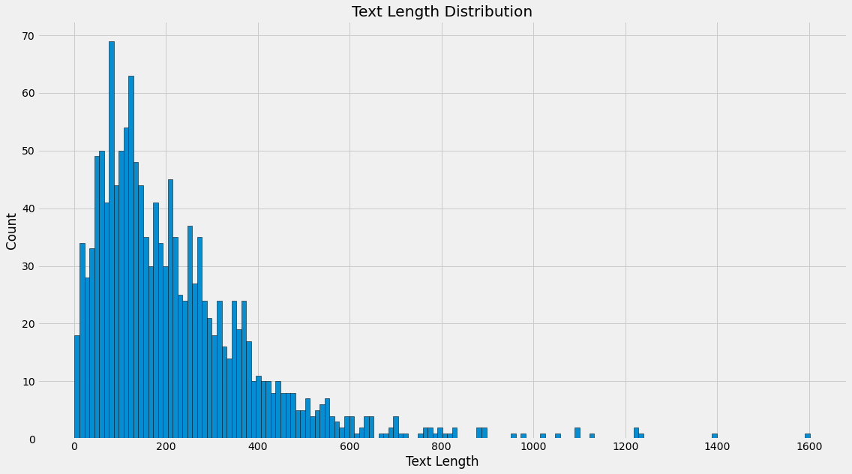
EDA: Text Length Distribution
Food Reviews

Slide 8
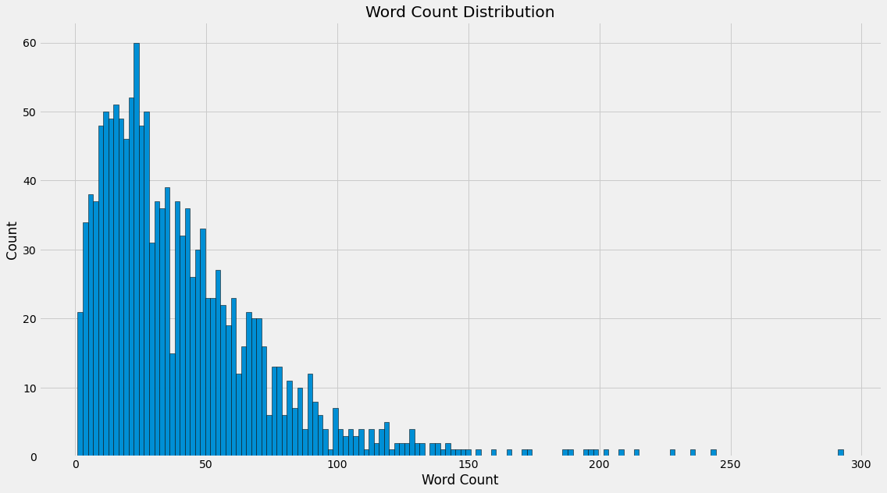
EDA: Word Count Distribution
Food Reviews

Slide 9
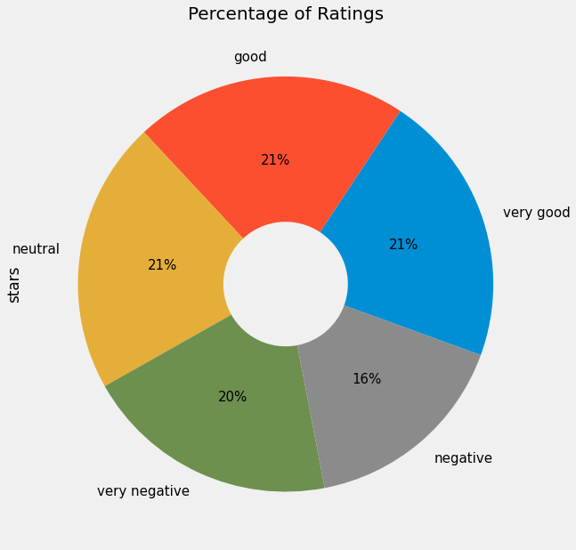
EDA: Distribution of sentiments
Food Reviews

Slide 10
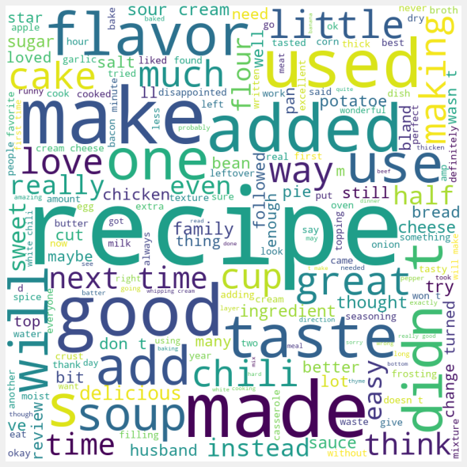
EDA: Word Cloud for Recipe Reviews

Slide 11
Data Processing
Text Cleaning
  Lowercase
  Remove Punctuation
  Remove Special Words
  Remove Digits
Preprocessing Operations
  Tokenization
  Removing Stop Words
  Lemmatization
Feature Extraction
  Bag of Word Model
  TF-IDF Model
  Word2vec
  One-Hot-Encoder

Slide 12
System Architecture
FastText
Convolutional Neural Network(CNN)
Recurrent Neural Network (RNN)
Long Short Term Memory
Attention bidirectional RNN
Hierarchical Attention Network(HAN)
Text Bidirectional RNN
Bert Model

Slide 13
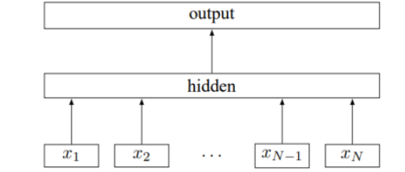
fastText
Convert bags of ngrams into word representations
These word representations are then averaged to create a text representation
Hidden variable that captures the meaning of the text
The text representation is fed to a linear classifier, which uses it to predict the probability of the text belonging to one of the predefined classes.
Figure 1: System Architecture [4]

Slide 14
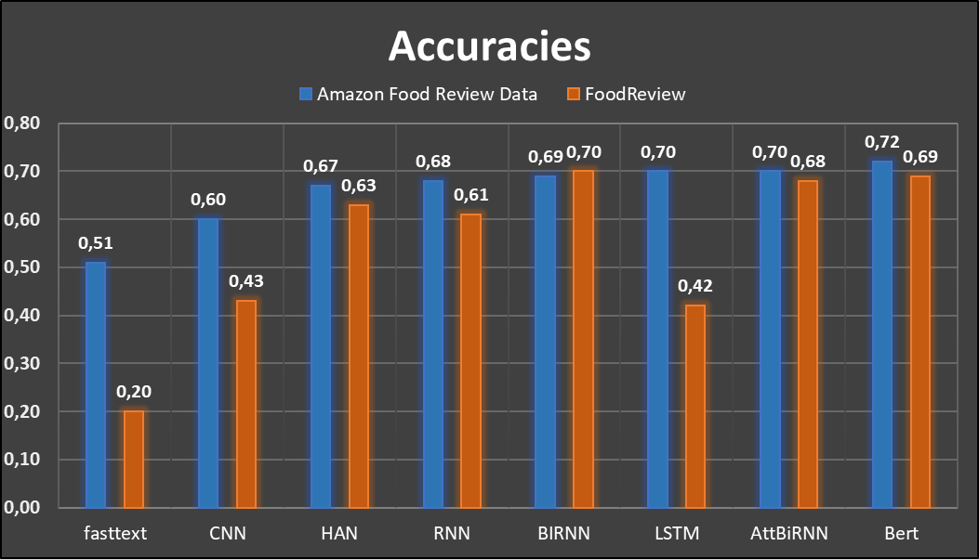

Slide 15
Conclusion
In this project, we will performed sentiment analysis on a dataset of food reviews, using a variety of different machine learning models and feature engineering techniques.
We aimed to understand the sentiment of the reviews across five specific classes (e.g. extreme negative, negative, neutral, positive, extreme positive).

Slide 16
Future Work
One area for future work would be to perform a more thorough hyperparameter tuning of the models to see if their performance can be improved.
Additionally, combining the predictions of multiple models, such as the bidirectional RNN and BERT, may result in a more robust and accurate model.

Slide 17
References
[1] Feng, Hua, and Ruixi Lin. "Sentiment Classification of Food Reviews." ArXiv, (2016). https://doi.org/10.48550/arXiv.1609.01933.
[2] https://www.kaggle.com/datasets/snap/amazon-fine-food-reviews
[3] https://www.tasteofhome.com/
[4] Joulin, A., Grave, E., Bojanowski, P., & Mikolov, T. (2016). Bag of tricks for efficient text classification. arXiv preprint arXiv:1607.01759

Slide 18
Thank You For Your Attention
Any Questions?

